Slide 1
Alpha-Fishing
30.1.2026
1. Fold 2C with capsid protomer conformations
2. Characterise hydrophobicity effect of proteins binding to 2C. Truncate 2C NTD in proteome screen, which should bind membrane, if proteins known to bind AAA+ATPase CTD (or homologues of which) bind NTD over CTD.
3. Set up priority screen of human proteome screen based on organelles.

Slide 2
  2C + capsomer co-folding
Immature and mature folds, VP0+1+3 and VP1+2+3+4 with and without 2C.
  1x protomer, triangular facet, and pentameric capsid assembly
  Ideally determine if maturation and/or protomer conformation changes 2C binding.
Model | ipTM | pTM
Immature | 0.86 | 0.87
Mature | 0.87 | 0.87
Immature + 2C | 0.74 | 0.75
Mature + 2C | 0.73 | 0.75
4 Pentameric models aligned, practically identical
  VP0+1+3 and VP1+2+3+4 with and without 2C
  Maturation has no effect as far as AF3 is concerned

Slide 3
  2C + capsomer co-folding
  Immature and mature capsomer, triangular facet, pentameric assembly
    Pentameric conformation adopted regardless of chain organization
Mature Model | ipTM | pTM
Capsomer | 0.91 | 0.92
Triangular facet | 0.66 | 0.69
Pentameric assembly | 0.87 | 0.87
Immature Model | ipTM | pTM
Capsomer | 0.85 | 0.87
Triangular facet | 0.60 | 0.64
Pentameric assembly | 0.86 | 0.87

Slide 4
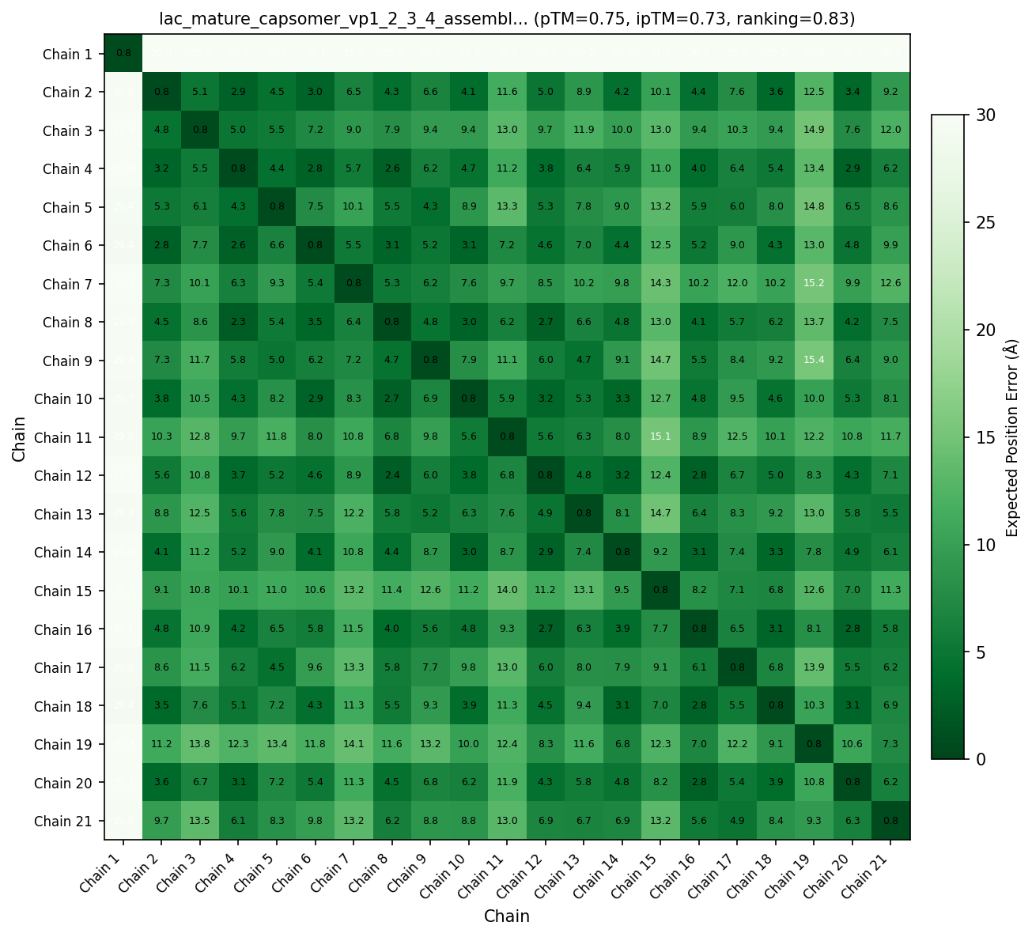
  2C + capsomer co-folding
  2C does not want to co-fold with capsomer regardless of chain-organization
    PAE plots have maximum error for 2C in all models

Slide 5

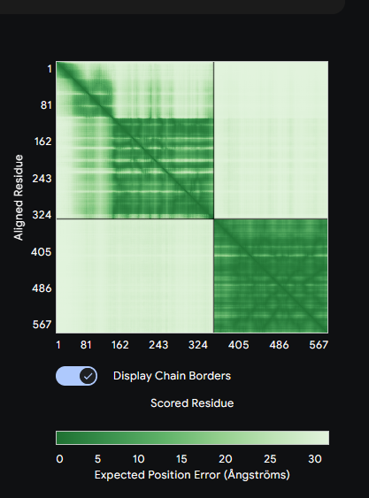
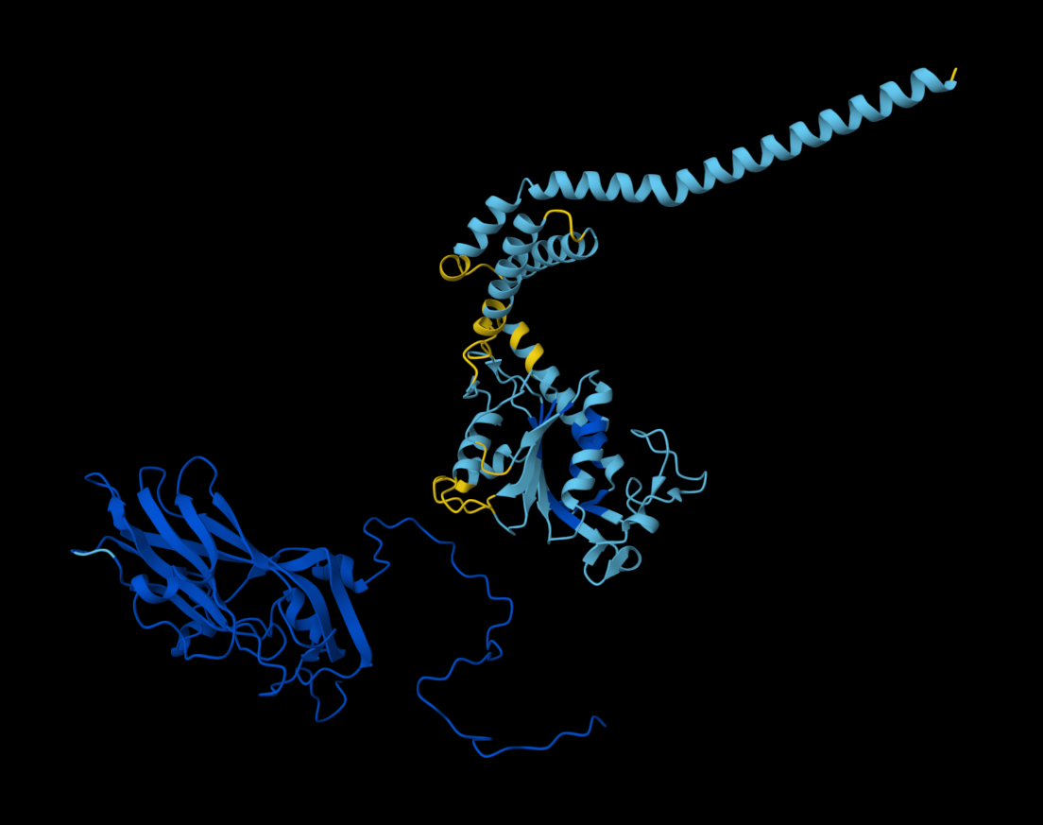
  2C + capsomer co-folding
  Summary
    Maturation of polyprotein matters little on structural models of capsomer.
    Models of capsomer, triangular facet, and pentameric assembly all adopt pentameric assembly conformation, likely due to templates having said conformation.
    2C does not want to co-fold with capsomer in any prediction, shows no preference to VP3.

Slide 6
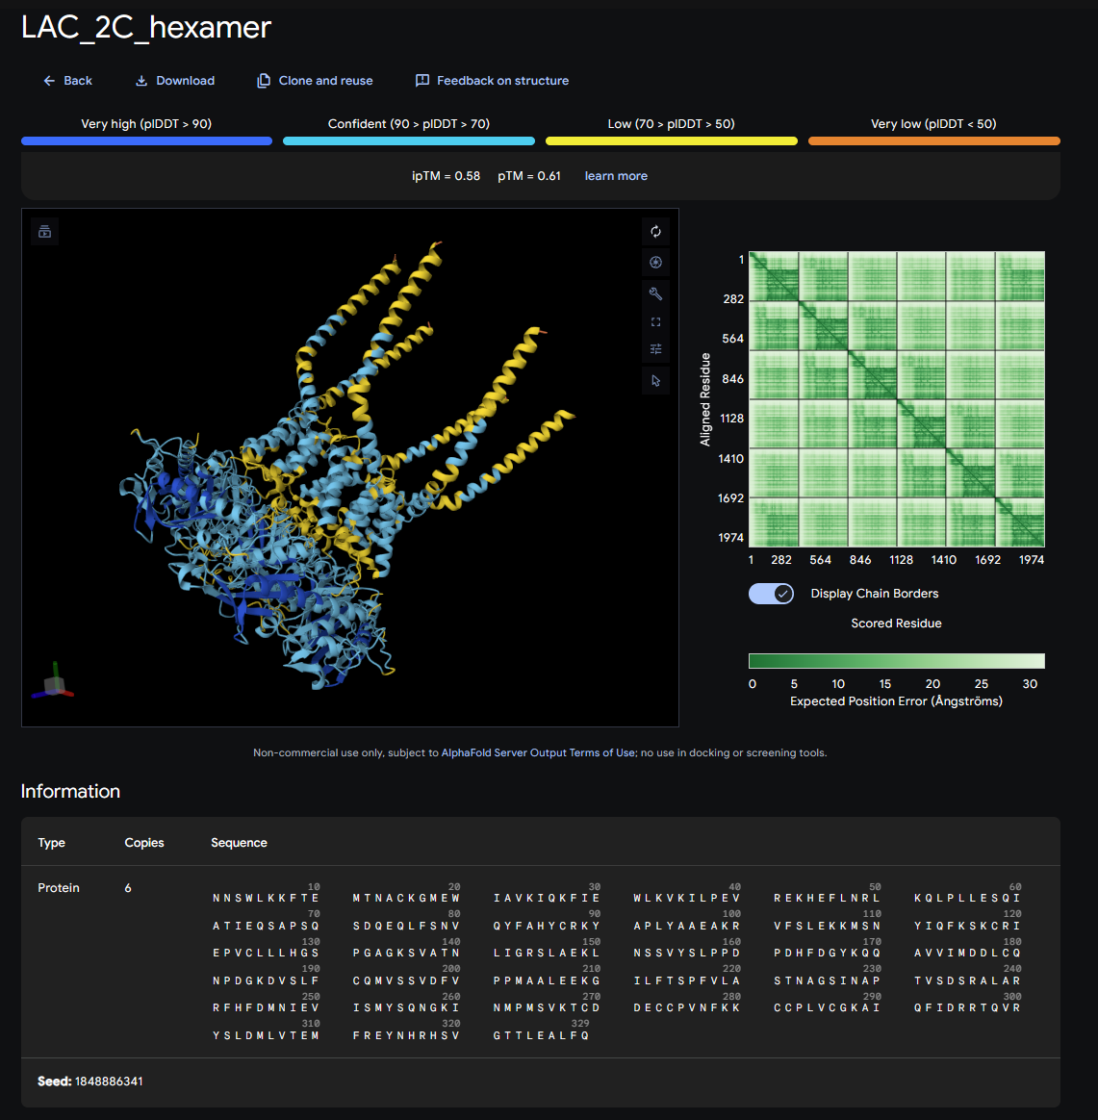
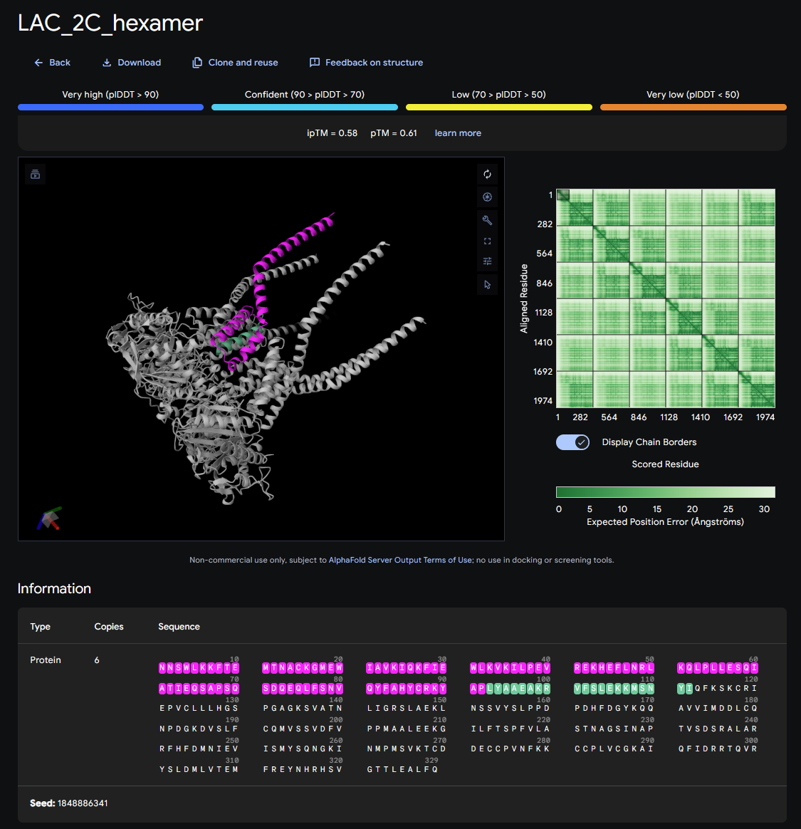
  Bind 2C NTD or CTD, will proteome screen just bind hydrophobic regions?
  2C NTD seems to be membrane binding part, at least over CTD

Slide 7
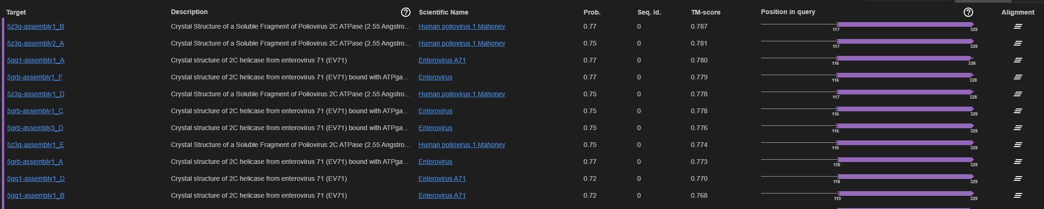
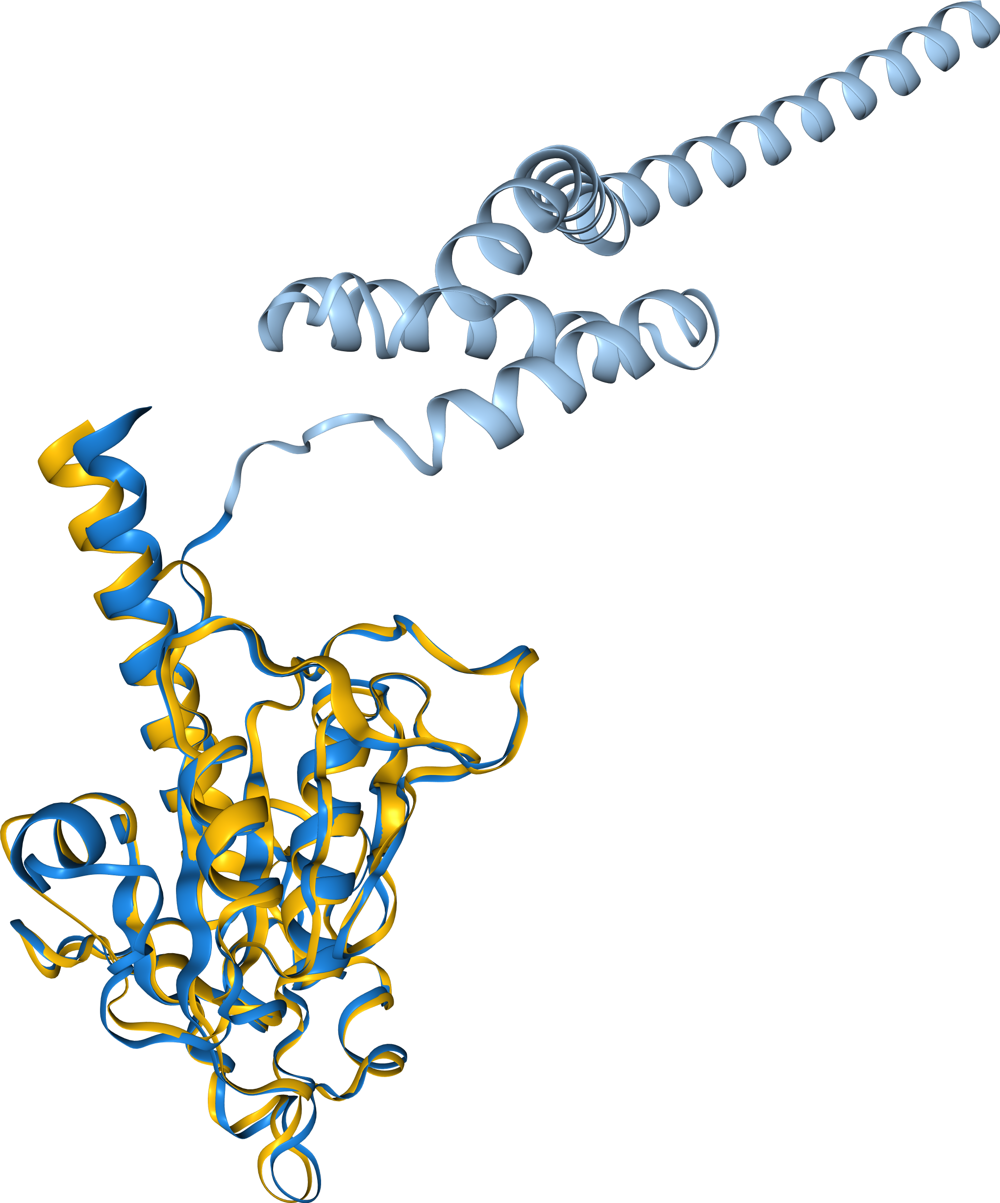
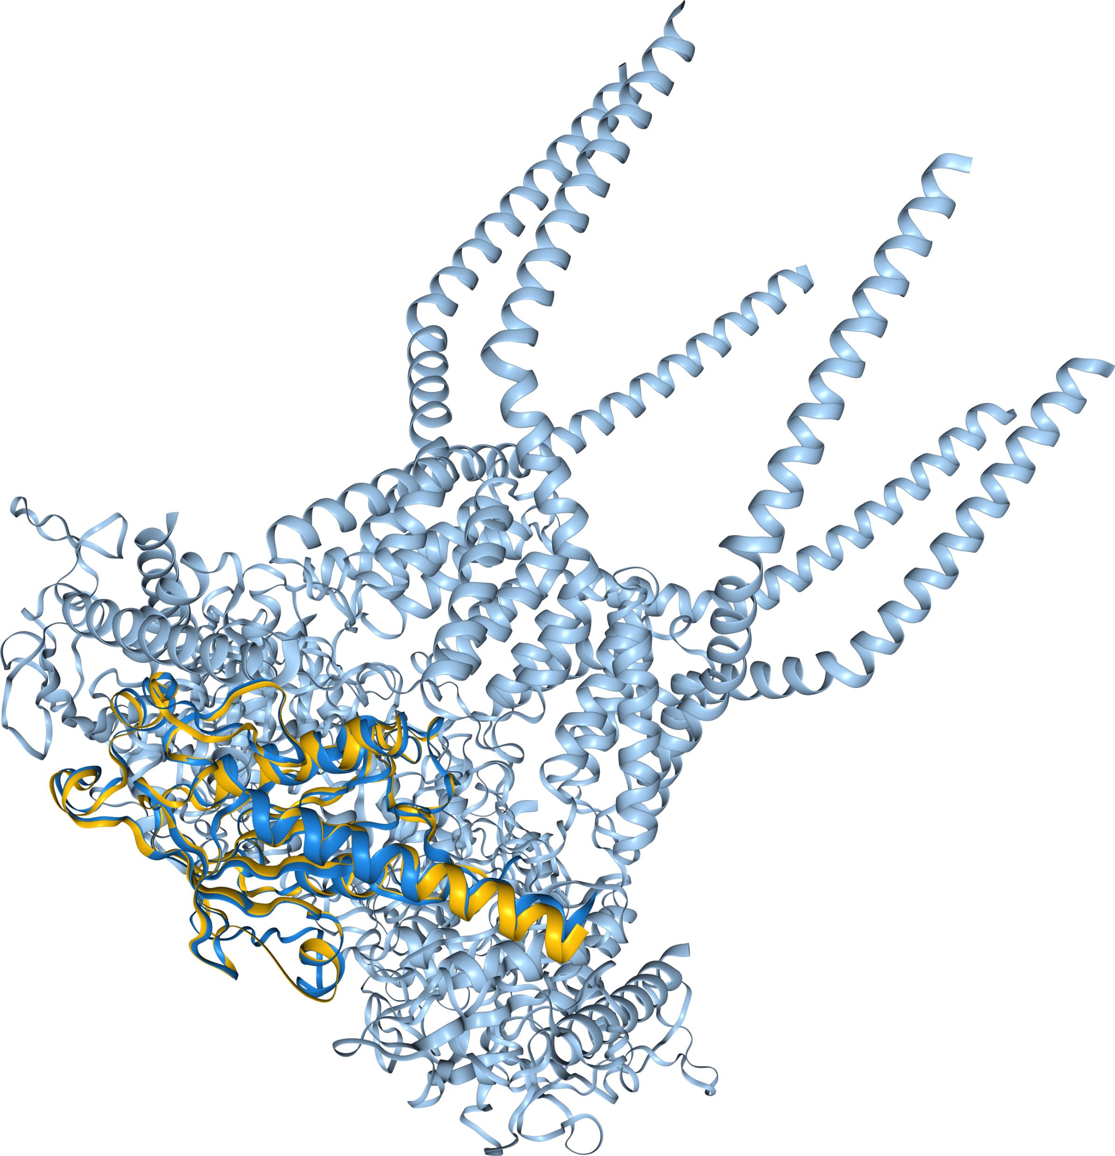
  Bind 2C NTD or CTD, will proteome screen just bind hydrophobic regions?
  2C CTD aligns well to multiple viral ATPases (2Cs), all hits missing NTD TM section

Slide 8
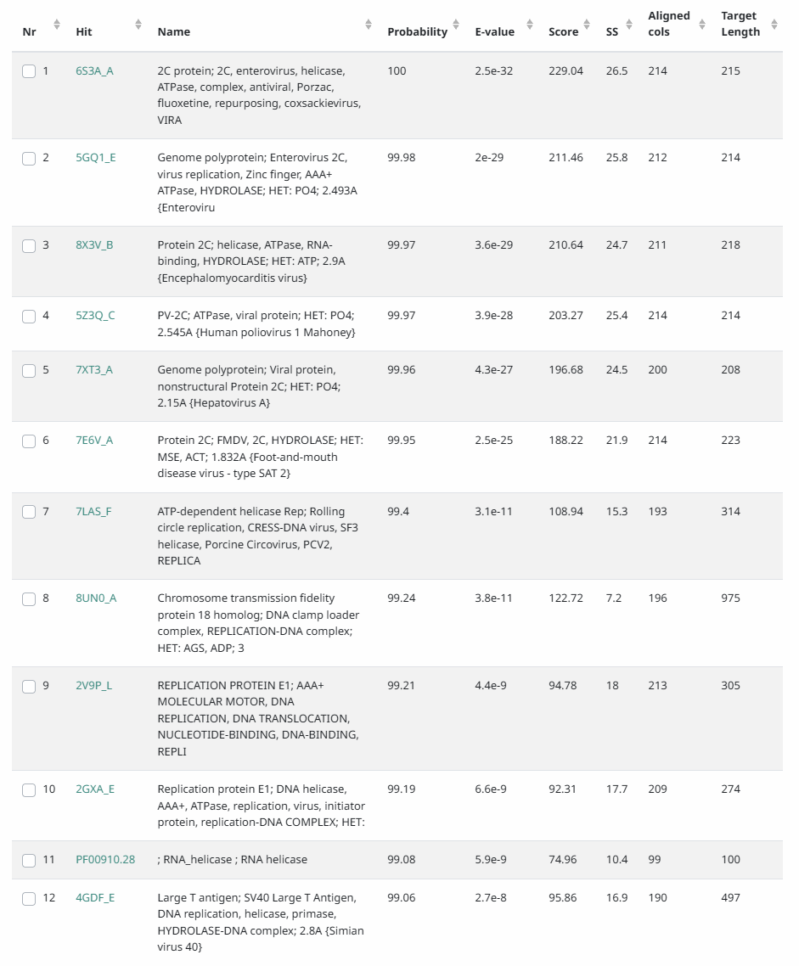
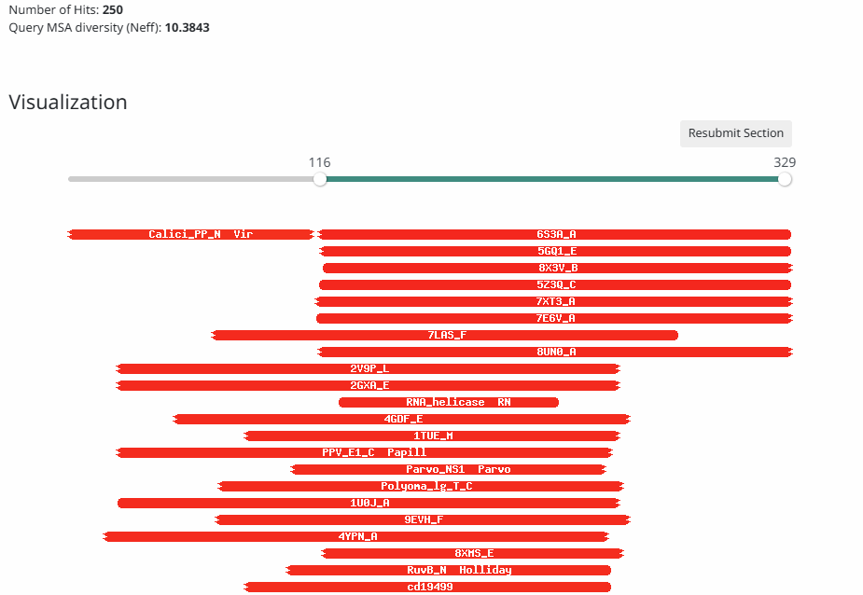
  Bind 2C NTD or CTD, will proteome screen just bind hydrophobic regions?
  2C has sequence and structure search hits to only viral ATPases, which are largely lacking from PPI databases (stringDB)
  Where it is found in PPIdbs (PPIDB, PPI3D) it only interacts with itself as the hexamer
  Difficult to find proteins that are known to bind viral ATPases to use as a control for hydrophobicity check.
  Two options
    No truncation to 2C, acknowledge NTD binding proteins might be false positives.
    Truncate NTD keep only ATPase domain only.
      (Based on foldseek search finding a lot of 2C without CTD I slightly favor option 2)

